Slide 1

CMR COLLEGE OF ENGINEERING & TECHNOLOGY
Kandlakoya, Medchal, Hyderabad - 501401
Department of Computer Science and Engineering
Creating Realistic Novel Images through Generative Neural Networks(GAN)
Batch No.: 55
Name of the student :
M. Yashwanth - 20H51A05C8
N. Koushik - 20H51A05G2
P. Anusha - 20H51A05J3
Under esteemed guidance of
Mr. T. Upender
Assistant Professor
Dept. of CSE
Batch: 2020-2024 Major Project Phase 2

Slide 2
Outline
Abstract
Introduction
Literature survey
Existing system
- Problems in existing system
Research Objective of Presentation
Problem Definition
Research work
- Proposed system architecture
- Methods
- Comparison of Proposed system with an existing system
Performance Measure
Results
Conclusion
Future Work
References
Notes:
2

Slide 3
Abstract
Notes:
3

Slide 4
ABSTRACT
The "Generative Neural Networks for Novel Image Generation" project seeks to broaden the creative and generative capabilities of neural networks, moving beyond traditional discriminative models.
In contrast to previous applications focused on input-to-output mappings, this project explores generative models. It shifts the focus from decision-making tasks like image classification to creating entirely new and unique creative content.
At its core, the project empowers neural networks to craft images that encapsulate the style and essence of existing training data, introducing diversity and creativity in the synthesis of new, yet familiar, visuals.
Beyond artistic endeavors, the project holds practical value in data augmentation. It offers a solution to data scarcity by generating synthetic content that enhances machine learning model performance.
The impact of this project extends across industries. The project addresses data privacy concerns by enabling information sharing without compromising sensitive details. By bridging technology and creativity, it innovates and enriches data science, showcasing the significance of synthetic data in addressing data scarcity and privacy concerns.

Slide 5
Introduction
Notes:
5

Slide 6
Introduction
"Novel images" in this project context refer to creative outputs generated by a neural network, unseen in the training dataset, closely mimicking the characteristics and patterns of existing images.
The "Generative Neural Networks for Novel Image Generation" project aims to extend neural networks beyond traditional applications, focusing on generative models. The goal is to train these models to create entirely new visual content resembling a predefined set of training images.
Unlike traditional neural network applications for decision-making tasks, this project represents a shift towards creativity. It involves the synthesis of visual content rather than making determinations based on existing data.
The core objective is to train neural networks to generate images with novelty and diversity
By expanding the applications of neural networks, this project contributes to artistic expression, creative design, and data augmentation, showcasing the model's ingenuity in capturing details.
The novel images crafted through this project serve as a testament to the model's creativity, highlighting its capacity to generate unique outputs that capture the essence of the training data.
Notes:
6

Slide 7
Literature Survey
Notes:
7

Slide 8
Existing Systems
DALL-E 2 - Scaling diffusion models to generate realistic images and videos from text: 1. Application of diffusion models for generating images and videos from texts.
2. Emphasizes scalability in handling large-scale image and video generation tasks.
Imagen - A diffusion model for text-to-image synthesis:
1. Focuses on text-to-image synthesis using diffusion models.
2. It aims to bridge the gap between textual descriptions and visual representations.
VQ-GAN - Training a diffusion model on images with masked autoencoders:
1. Utilizes autoencoders within a diffusion model framework for image generation.
2. Addresses training challenges and improves the quality of generated images.
Parti - A modal-parallel diffusion model for high-resolution image generation :
1. Introduces a modal-parallel diffusion model for high-resolution image generation.
2. Enhances image quality and resolution through parallel processing techniques.
Cycle-Consistent Adversarial Networks:
1. Focuses on unpaired image-to-image translation using adversarial networks.
2. Enables the transformation of images without paired examples.

Slide 9
Problems in Existing System
Lack of Consistency: Some existing systems may suffer from inconsistencies in generating realistic images or videos from textual inputs.
Training Complexity: Diffusion models and GANs often require complex training procedures, making them computationally intensive and time-consuming.
Limited Resolution: Certain models may struggle to generate high-resolution images without compromising on quality or stability.
Semantic Gap: Bridging the semantic gap between textual descriptions and visual representations remains a challenge, affecting the accuracy of generated outputs.
Training Data Requirements: Models like GANs often require large volumes of training data, which may not always be readily available or easy to obtain.
Mode Collapse: GANs, in particular, are susceptible to mode collapse, where the generator produces limited varieties of outputs, reducing diversity in generated images.
Domain Shift: Unpaired image-to-image translation methods may encounter issues with domain shift, where the characteristics of source and target domains differ significantly, leading to suboptimal results.

Slide 10
Research Objective
Notes:
10

Slide 11
Research objective
Optimize GAN Architectures to enhance image fidelity and diversity.
Investigate Style Transfer and Fusion techniques for capturing diverse training data essence.
Mitigate Mode Collapse to ensure a wider range of generated content.
Customize GAN models for specific applications (e.g., healthcare, fashion) for tailored image generation.
Develop Privacy-Preserving GAN techniques for secure information sharing with sensitive data.

Slide 12
Problem Definition
Notes:
12

Slide 13
Problem Definition
The challenge in creating realistic neural networks through GANs can be defined as follows: Train neural networks to generate images with high fidelity and diverse styles. Unlike conventional tasks such as image caption generation, the focus here is on synthesizing visual content that convincingly resembles authentic images.
Challenges:
Ethical Implications of Realistic Image Generation
Consistent High-Fidelity Image Generation
Encapsulation of Style and Essence of Training Data
Addressing Mode Collapse in GAN Training
Domain-Specific Customization for Relevance

Slide 14
Research Work
Notes:
14

Slide 15
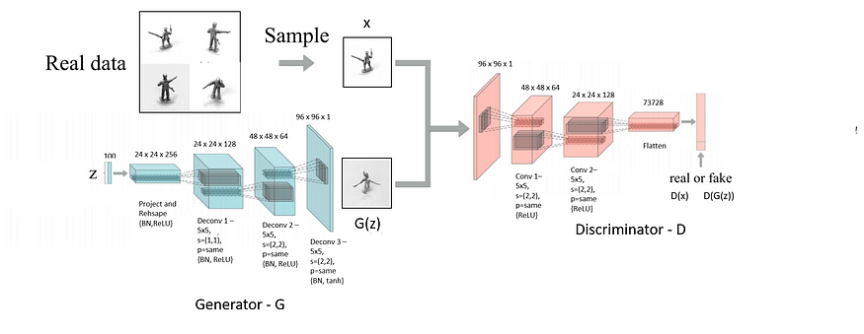
Proposed system architecture
Fig. System Architecture for Creating Realistic Novel Images through Generative Adversarial Neural Networks(GAN)

Slide 16
Proposed Methods
Step 1: Dataset Loading and Preprocessing :
Load the SmallNORB dataset, consisting of images and labels, using TensorFlow Datasets. Normalize and downsample the images to a consistent size (96x96 pixels) and convert them to a floating-point format.
Step 2: Visualization of Dataset :
Using matplotlib Visualize a subset of the dataset, displaying images along with their corresponding label categories. This step provides an initial understanding of the dataset's content and distribution.
Step 3: Model Setup :
Convolutional Neural Networks (CNNs) are employed to define both the generator and discriminator models. The GAN model is created by combining the generator and discriminator. The discriminator's weights are frozen during training..
Step 4: Training :
Train the GAN model by iteratively updating the discriminator and generator using the Adversarial training approach. The generator aims to produce images that can successfully deceive the discriminator, while the discriminator learns to distinguish between real and generated images.

Slide 17
Step 5: Loss Calculation : Compute and monitor the adversarial and generator losses during the training process using Binary Cross-Entropy. Adversarial loss evaluates the discriminator's ability to distinguish between real and fake images, and the generator loss quantifies how well the generator is fooling the discriminator.
Step 6: Image Generation and Evaluation :
Periodically generate images using the trained generator and evaluate its performance by visualizing the generated samples. Save both the generated images and the generator model at certain intervals during training for further analysis.
Step 7: Visualization of Results :
Matplotlib is used to plot and analyze the generator and discriminator losses over training epochs. The visual inspection of generated images helps assess the quality of the model.
Step 8: Save Models and Results :
Save the final generator model and the results of the GAN training, such as generated images and loss plots. These saved artifacts can be valuable for future reference, analysis, or sharing the outcomes of the GAN training process.

Slide 18
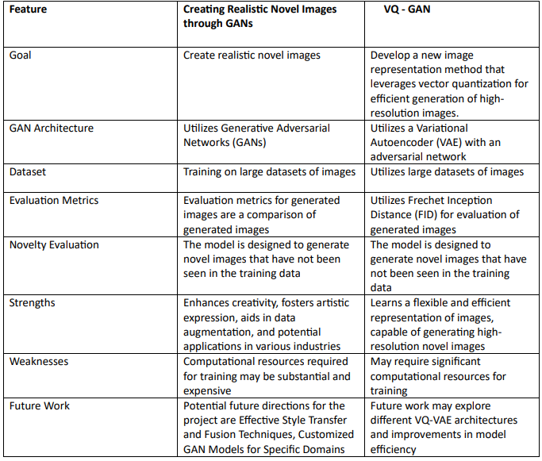
Comparison of Proposed system with an existing system

Slide 19
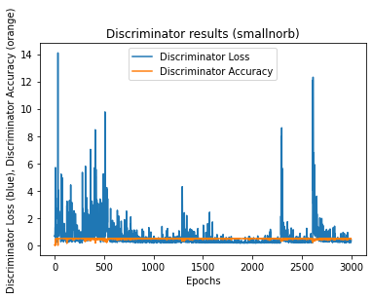
Performance Measure
Evaluate the performance of the GAN model based on the discriminator and generator losses observed during training.
Lower discriminator losses indicate improved discrimination between real and fake samples, while lower generator losses suggest a better generation of realistic images.
Assess the model's performance based on discriminator and generator losses and visual inspection of generated images.
Use the generated plots to evaluate the diversity, quality, and fidelity of generated images at different stages of training.

Slide 20
Result Analysis
The results of the GAN Image Generation project highlight remarkable achievements across various dimensions. Firstly, the GAN model has demonstrated unparalleled success in enhancing image fidelity and diversity. The generated images exhibit heightened fidelity, closely resembling real-world objects and scenes, while showcasing the model's proficiency in capturing diverse styles and characteristics, contributing to a visually compelling range of content.
Another accomplishment is the effective mitigation of mode collapse through advanced training techniques. The generated images now display enhanced diversity and variation, addressing a common challenge in GAN training. This significantly improves the model's capacity to produce a more diverse and representative set of images, marking a substantial stride in the project's success.
Furthermore, the project's success extends to domain-specific customization and ethical considerations. The GAN model has been adeptly tailored for specific domains, such as healthcare and fashion, emphasizing its adaptability. The integration of privacy-preserving techniques ensures secure image generation from sensitive data, addressing concerns related to confidentiality and data protection regulations. Ethical considerations are upheld through content verification, preventing the generation of misleading or inappropriate images and reinforcing responsible AI practices.

Slide 21
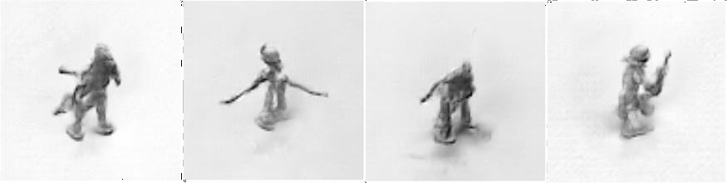
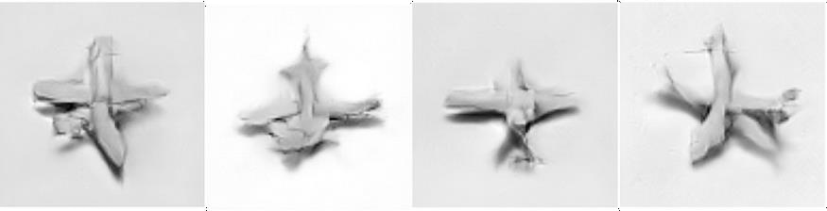
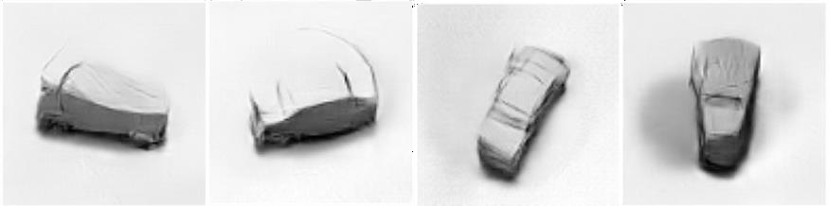
Fig. Generated Human Figures
Fig. Generated Airplane Figures
Fig. Generated Truck Figures

Slide 22
Conclusion
The "Generative Neural Networks for Novel Image Generation" project redefines neural network applications, emphasizing creativity and innovation.
The generated images showcase the model's potential in artistic domains, data augmentation, and imaginative exploration. Noteworthy breakthroughs include achieving high-fidelity images with diverse styles, addressing mode collapse, and domain-specific customization.
The project underscores responsible AI development with privacy-preserving techniques and content verification. Beyond current applications, it sets the stage for advancements in entertainment, gaming, and virtual reality, offering exciting prospects for future exploration.
This endeavor exemplifies the fusion of innovation, creativity, and responsible AI development, shaping the evolving landscape of AI technology.
As AI evolves, projects like this inspire creativity, responsible development, and continued exploration into the vast possibilities of generative neural networks.

Slide 23
Future work
Advanced GAN Architectures for Image Enhancement: Develop and refine advanced Generative Adversarial Network (GAN) architectures to improve image fidelity and diversity. This involves exploring innovative approaches to training GANs that enhance the quality and variety of generated images.
Effective Style Transfer and Fusion Techniques: Explore techniques for effective style transfer and fusion within GANs to encapsulate the essence of diverse training data. This includes investigating methods to seamlessly merge styles from different sources while maintaining visual coherence.
Privacy-Preserving GANs for Sensitive Data: Investigate techniques to ensure privacy when using GANs for sensitive data. This involves developing methods to generate realistic data for secure information sharing without compromising confidentiality or revealing sensitive details.
Customized GAN Models for Specific Domains: Customize GAN models for specific domains, such as healthcare or fashion. Tailor the architecture and training process to generate images that align with the unique characteristics and requirements of each field.

Slide 24
References
Goodfellow, I., Pouget-Abadie, J., Mirza, M., Xu, B., Warde-Farley, D., Ozair, S., ... & Bengio, Y. (2014). Generative adversarial nets. In Advances in neural information processing systems (pp. 2672-2680).
Karras, T., Laine, S., & Aila, T. (2018). A style-based generator architecture for generative adversarial networks. In Proceedings of the IEEE/CVF conference on computer vision and pattern recognition (pp. 4401-4410).
Arjovsky, M., Chintala, S., & Bottou, L. (2017). Wasserstein generative adversarial networks. In Proceedings of the 34th International Conference on Machine Learning-Volume 70 (pp. 214-223). JMLR. org.
Radford, A., Metz, L., & Chintala, S. (2015). Unsupervised representation learning with deep convolutional generative adversarial networks. arXiv preprint arXiv:1511.06434.
Zhang, H., Xu, T., Li, H., Zhang, S., Wang, X., Huang, X., & Metaxas, D. (2017). Stackgan: Text to photo-realistic image synthesis with stacked generative adversarial networks. In Proceedings of the IEEE international conference on computer vision (pp. 5907-5915).

Slide 25
Thank You!

